Slide 1



Web programming with JS & Exploring JS (1)
By Elham Jaffar

Slide 2
Recapping JavaScript

Slide 3
Web performance or website optimization simply means optimizing the speed of web elements (pages, images, other file formats etc.) which are downloaded or displayed on the user’s web browser.
Performance

Slide 4
Performance
Tips: 11 Tips of JS optimization
Measure website’s speed:
performance.now()
Insights PageSpeed Tool by Google

Slide 5
Performance
let t0 = performance.now(); doSomething(); let t1 = performance.now(); console.log("Call to doSomething took " + (t1 - t0) + " milliseconds.");
It shows up to microsecond resolution.

Slide 6
Repaint Vs reflow
Repaint
A repaint occurs when changes are made to an elements skin that changes visibly, but do not affect its layout.
Examples of this include outline, visibility, background, or color. According to Opera, repaint is expensive because the browser must verify the visibility of all other nodes in the DOM tree.
Reflow
A reflow is even more critical to performance because it involves changes that affect the layout of a portion of the page (or the whole page).
Examples that cause reflows include: adding or removing, content changing width, height, font-family, font-size and more.

Slide 7
Web accessibility refers to the inclusive practice of removing barriers that prevent interaction with, or access to websites, by people with disabilities. When sites are correctly designed, developed and edited, all users have equal access to information and functionality.
Accessibility

Slide 8
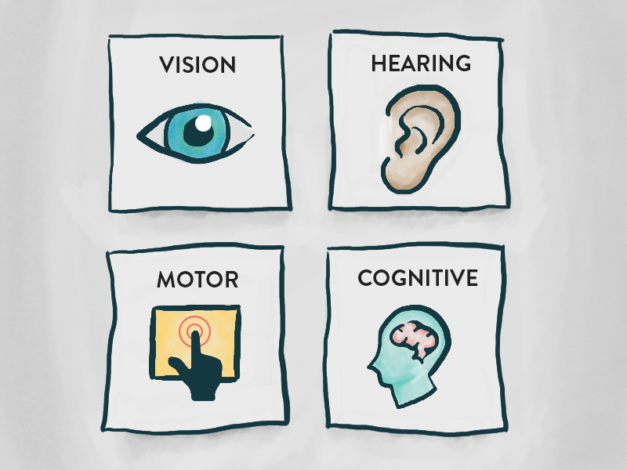
Main types of Impairment
Accessibility Guideline

Slide 9

Screen Reader
Screen readers are software programs that allow blind or visually impaired users to read the text that is displayed on the computer screen with a speech synthesizer or braille display.
Use ChromeVox

Slide 10
Focusable
It’s important to make sure that our websites are navigable by keyboard.
HOW? Use: tabindex. It is a global attribute, enabling any element to receive tab focus.
Not all elements are focusable, so if the element doesn’t need a user interaction, it is no need to use focus.

Slide 11
Skip links?
It means skip to main content to avoid navigating on all the side contents.
First, a screen reader will always try to read aloud any navigation it comes across, on every page load, no matter what. This can become annoying to those users. Providing a mechanism with which to quickly bypass it can greatly improve their experience.
Second, users who rely on only a keyboard for navigation (those with motor disabilities like paralysis or conditions like Parkinson’s disease) can also quickly bypass navigation containing many links. More Info !

Slide 12
Semantics
Semantics refers to the meaning of a piece of code — for example "what effect does running that line of JavaScript have?", or "what purpose or role does that HTML element have" (rather than "what does it look like?".)
User Interface Elements

Slide 13
Role, value and name
With screen reader:
Role: What type of this element it is ?
Value: It reads the current/default value
Name: It reads element name
State: It reads current states. Selected? Checked?
NOTE: Always use alt attribute with element.

Slide 14
ARIA
Accessible Rich Internet Applications
Defines a way to make Web content and Web applications more accessible to people with disabilities.
You can use it by adding a role to element with no semantics like “div” or to modify semantics element like “button”
More Info!

Slide 15
Reward System
Notes:
https://www.w3resource.com/javascript-exercises/javascript-function-exercise-6.php

Slide 16
Pixel Maker Lab
Notes:
https://www.w3resource.com/javascript-exercises/javascript-function-exercise-6.php

Slide 17
Memory Game Project
Notes:
https://www.w3resource.com/javascript-exercises/javascript-function-exercise-6.php

Slide 18
Exercise Challenge (1)
Write a JavaScript function that accepts a string as a parameter and find the longest word within the string. Sample Data and output: Example string: 'Web Development Tutorial' Expected Output: 'Development'
Notes:
https://www.w3resource.com/javascript-exercises/javascript-function-exercise-6.php

Slide 19
Exercise Challenge (2)
Write a JavaScript program which accept a string as input and swap the case of each character.
For example if you input:
'The Quick Brown Fox'
The output should be:
'tHE qUICK bROWN fOX'
Notes:
https://www.w3resource.com/javascript-exercises/javascript-array-exercise-9.php

Slide 20

Remember that we are here to help you
All you have to do is ASK!
Thank you for Attending

